Slide 1

Reminder!
CVC has a zero-tolerance policy for:
racist / sexist / homophobic / ablist / transphobic behaviour and language.
Offensive language may include:
Words like the n-word and the f-slur.
Comments about someone’s physical appearance (e.g. skin colour).
Negative references to someone’s religion, language, ethnicity, race, sexual orientation, gender.
All of this behaviour is sanctioned in line with our safer corridors policy, and followed up in other ways, too.
Please help us ensure that everyone feels safe and happy at CVC:
To report an incident, you can:
Email Ms Burns: pburns@combertonvc.org
Email: safeguarding@combertonvc.org
Tell your form tutor.
Tell your head of year.
Tell a teacher you feel comfortable with.
We can’t do this without you!

Slide 2
Student Leadership
Notes:
INTRODUCTION : Charlie

Slide 3
Student leadership Roles
Stewards
School Council

Slide 4
Stewards
A stewards role involves preparation for the evening, car parking, greeting people, directing guests and serving refreshments.
A steward is a student that help with the Year 12 Open evening, Year 6 Transition day, Year 6 Open evening, Year 9 Options evening and other events.
Helping at Productions selling raffle tickets, checking tickets and watching the event for free
Helping with Careers events for Years 9,10,11 and 12
Helping with the second-hand uniform sales
Helping with events organised by the Friends of the Trust

Slide 5
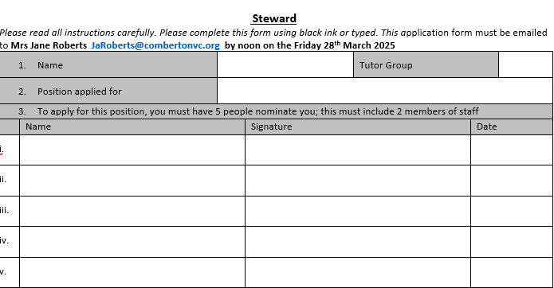
Stewards

Slide 6
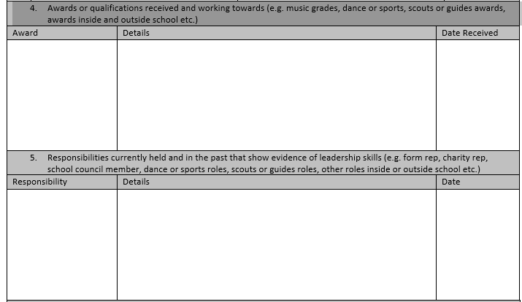
Stewards

Slide 7
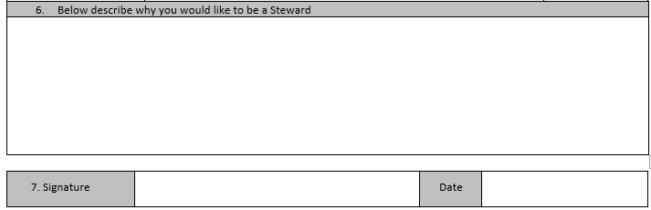
Stewards

Slide 8
Stewards
This application form must be emailed to Mrs Jane Roberts JaRoberts@combertonvc.org by noon on the Friday 28th March 2025

Slide 9
School Council
School councils are a vital part of the educational experience for many young people as they promote pupil voice and empower students to take an active role in their education.
The activities that students at Comberton Village College engage in are
Organising events and fundraisers such as Christmas Bazaar
Advocating for student needs: School councils can provide a platform for students to voice their concerns and advocate for changes to school policies or practices.
Planning school improvements: School councils can work with school leaders or the Friends of the Trust to identify areas for improvement, such as facilities or curriculum, and develop action plans to address these issues.

Slide 10
School Council
Why would you like to be on the school council?
Must be emailed to Miss Segal msegal@Combertonvc.org
by noon on the Friday 28th March 2025

