Slide 1
eBooks
at Comberton Village College
A Parents’ Guide

Slide 2
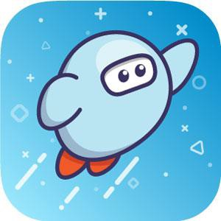

Sora
We offer pupils access to eBooks and audiobooks via the Sora app, from a company called OverDrive Education.
Multi-award winning, this app is the market leader in educational reading apps.
It can link to Cambridgeshire Public Libraries, further
extending student’s access to reading material.

Slide 3
Graphic and Manga books
Unlike other eLibraries, Sora includes a collection of graphic novels and Manga.
These are very popular with pupils.
They are useful in encouraging reluctant readers, and can
be a “gateway” to traditional books.
Imagery can boost reading comprehension for pupils with EAL or for those who experience difficulty in reading traditional texts.

Slide 4
Audiobooks
Our new subscription includes eAudio.
Pupils who might struggle reading more challenging texts have the option of listening to their books while following the text on a screen, or in a hard-copy from the library.
These are narrated stories, not computer generated
voices.

Slide 5
Will eBooks stop my child reading real books?
Absolutely not!
Pupils in KS3 have allocated reading lessons as part of their English curriculum. Most of these are held in the school library.
Within these lessons, pupils are usually asked to read a traditional book, as the reading experience is quite different.
Our friendly library staff are available to help pupils navigate the thousands of books on offer, making suggestions and encouraging feedback.

Slide 6
Where does my child start?
On your computer go to: https://soraapp.com/library/uksecondary
Or on a smart-device, download the “Sora” app.
Select Comberton Village College, and then use your
child’s school computer login.
If your child has a school iPad, they should have already been introduced to this app during their English lessons.

Slide 7



How do they choose a book?
Start at the Explore tab at the bottom of the page.
Here you can find collections of titles that might appeal, such as Award
winners, Pride books, or trending topics.
Try putting a key word or genre like “Sport” or “Mystery” in the search box.
Search for a book you enjoyed – you’ll find links on it’s page to all the
different collections it is in and you can find something similar within those.
Or look at the library CATalogue page. Links on the right take you to “Who
Else Writes Like…?” and “Who Next…?”, websites that will suggest a new
author based on an author that you have already enjoyed. (One covers
adult fiction, the other covers youth fiction.)
Or ask a Librarian! They’re here to help!

Slide 8
Good to know…
Books go out for two weeks.
Pupils can take up to 5 at a time.
They can have up to 3 reservations at a time.
Books auto-delete after that time, so they can’t go overdue.
Assuming there’s no waiting list, books can be re-issued straight away if not
finished in time.
Pupils can “return” books early if they’ve finished them. Go to their “Shelf”, find
the book and go into the options.
Pupils who have the app on multiple devices can synch their progress in a
given book.
When a book is borrowed, it should automatically download on to the device.

Slide 9

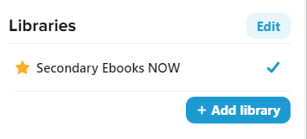
How do I add public library books?
You need a public library card – e.g. from Comberton,
Cambourne, St Neots or Cambridge Central Libraries.
Within Sora click the menu button, top right:
Click on “+ Add library”
Search for Cambridgeshire County Council and add it.
You can use the side menu to switch between which library you are looking in, school or public.
When you borrow a public library book you will need to use your
library card number e.g. DD20030012345 and PIN the first time.

Slide 10
Problems?
Come to the library and ask the library team.
Open 8am – 4pm daily.
Email the school librarians:
COM-Librarians@combertonvc.org
Please note the Library staff will only occasionally log in during the holidays, so there may be a delay in our response.

