Slide 1
Activities week
2026

Slide 2
Trips abroad
Malaga– Yr 8 already launched last Term – if you have a place on this trip no need to complete your activities week forms.
Dali Art Trip- Year 9 launched last Term – if you have a place on this trip no need to complete your activities week forms.
Battlefields History Trip Year 8 and 9 Approx £462

Slide 3
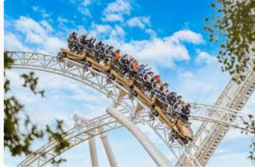
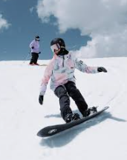

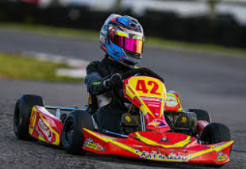


Slide 4
Options
Full weeks- Monday to Friday
Activity | Approximate cost £
Dance | 90
Speed Week | 250
Music | 55
Adrenaline week | 220
Snow Boarding | 220
Music tech | 100

Slide 5
Different activity days-Choose one band
Band | Mon | Tue | Weds | Thurs | Fri | Cost £
1 | Tower of London | Grafham | Spray Can Art | Murder Mystery | Printmaking | 120
2 | Spray Can Art | Frisbee | Murder Mystery | Grafham | Duxford | 122
3 | Duxford | Spray can Art | Frisbee | Terrible Tours of Cambs | Grafham | 138
4 | Printmaking | Cinema | Electronics | Jesmonite casting | Grafham | 117
5 | Duxford | Grafham | STEM Challenge | Print-making | Murder Mystery | 116
6 | Tower of London | Printmaking | Jesmonite Casting | Grafham | Duxford | 134
7 | STEM Challenge | Loop lab | Cinema | Terrible Tours of Cambs | Electronics | 48
8 | Jesmonite Casting | Yoga | Cinema | STEM Challenge | Norwich Castle | 50
9 | Electronics | Jesmonite Casting | Cinema | Yoga | Norwich Castle | 52

Slide 6
Band | Mon | Tues | Weds | Thurs | Fri | Cost £
10 | Health and Social Care | Health and Social Care | Health and Social Care | Cinema | Health and Social Care | 27
11 | Crafty | Crafty | Crafty | Cinema | Crafty | 27
12 | Board Games | Cinema | Board Games | Board Games | Board Games | 37
13 | Beauty week - Nails | Cinema | Beauty week- Feet | Beauty week- Facials | Beauty week- Lashes | 107
14 | Animation | Animation | Animation | Animation | Norwich Castle | 16
15 | Organ Playing | Organ playing |  |  |  | 5

Slide 7
Selection process
Look carefully and discuss the options with your parents - especially the cost.
Check the Comberton Post mailing sent on 9th January to complete the form. You must select 3 activities in order of preference and be willing to do any of your choices.
Year 9s must choose different activities to last year.
Forms must be completed by 23rd January.
You will then be allocated into one of your chosen weeks.
Please note – there will be no switching between weeks- once in a week you will stay with that group for the entire time.

Slide 8
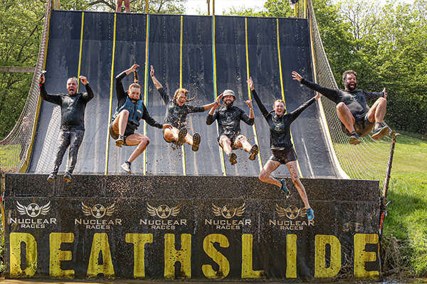
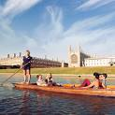
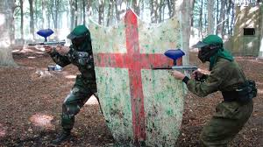
Adrenaline Week
This is a full week of off-site activities such as Nene Park Water sports, Paintballing (Thetford), Nuclear Races, Wyboston Water Park, Punting and the Playground (Waterbeach).
There will be two groups of a max size of 80.

Slide 9

Stop Frame Animation Week
You will spend Monday to Thursday on site creating a short stop frame animation film.
Please bring your own Lego / plasticine and iPads
On Friday, you will visit Norwich Castle

Slide 10
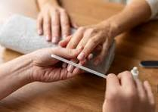

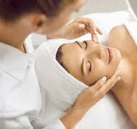
Beauty Week
What will we do: Spend 4 days week learning about the industry and some treatment techniques such as nails, pedicures, make up etc. This is a school based activity with a trip to the cinema planned for the Tuesday.

Slide 11
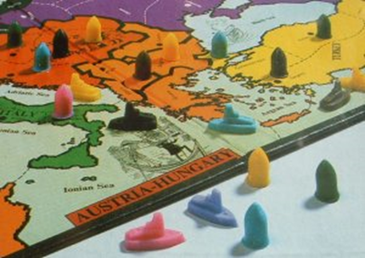
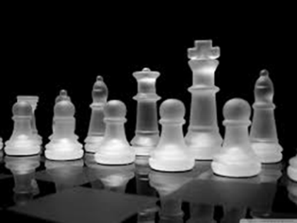
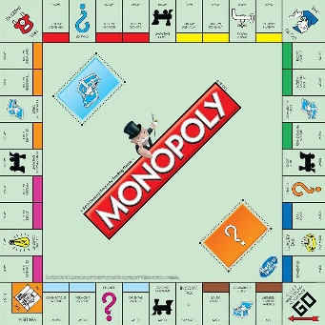
Board Games Week
Do you have the skills to become a Comberton Board Games Champion?
Want to try out some new games or play some old favourites?
There will be a different selection of games to play every day and a running championship throughout the week.
You can bring your own games from home
The winner will receive a prize at the end of the week
This is an onsite based activity with a trip to the cinema planned for Tuesday.

Slide 12
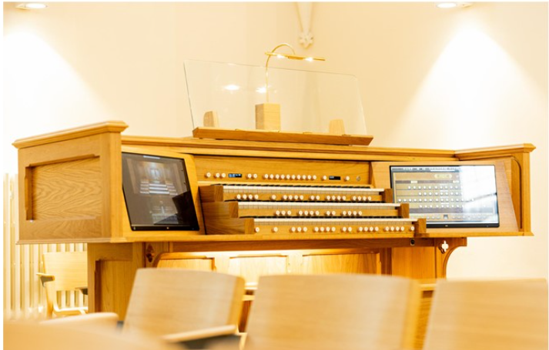
Play a Church Organ
What will we do? Spend a day playing and learning about one of the newest and most versatile church organs in Cambridge. Mr Dawes is co-director of music at Downing Place United Reformed Church near the centre of Cambridge. The church has a Hauptwerk digital organ, with three manuals (three separate keyboards) and a pedalboard. See photo of the organ)
We will travel to Cambridge on the public bus, have an introduction to the organ before having he opportunity to play and to get to know the organ. While others are playing, the students will be able to listen or to learn more about organs and how they work.
There will be the opportunity to walk into Cambridge to buy lunch or to eat a packed lunch. Later, we will listen to a short recital, before returning to Comberton for the end of the school day.
Who could take part?
This activity would be ideal for students who have piano or keyboard lessons. You will bring some piano music with you to play, and organ music will be provided too.

Slide 13

Cinema Trip
We will travel into Cambridge to see a film (decided nearer the time) before we have a picnic together at Lammas Land.
Available as a one day activity within Bands 4, 7, 8, 9, 10, 11, 12, 13 and 14.

Slide 14
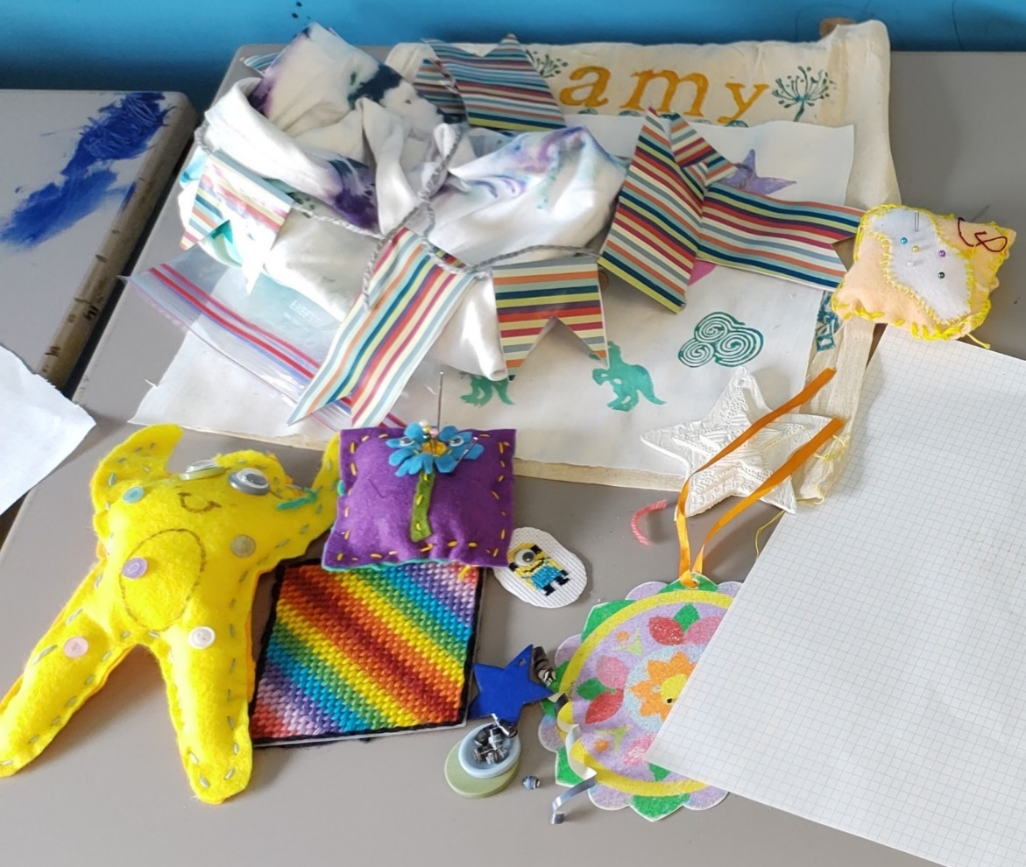
Crafting
Get a chance to experience a wide range of crafts throughout the week, including cross stich, jewellery making, making a bean bag, tie dye, wreath making, enamelling, paper crafts and more. Best of all, you get to take all your crafts home at the end of the week!
You will be crafting for 4 days with a trip to the cinema on the Thursday.

Slide 15

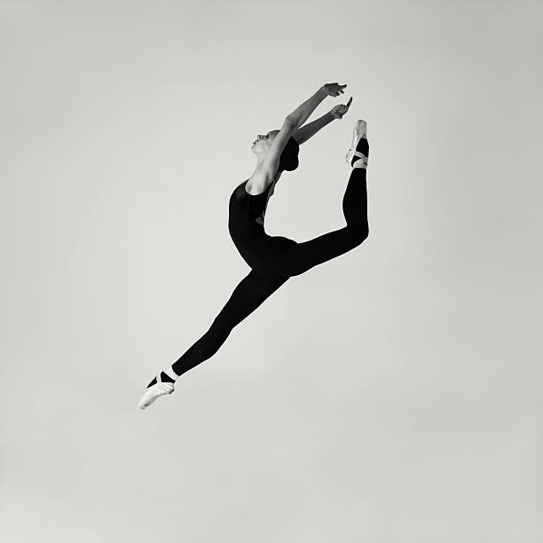
Dance Week
What you will do:
You will take part in fun and energetic workshops in school with professional artists from Nikki-Louise Dance Academy.
At the end of the week, there will be a showcase and a copy of the performance to keep. This activity is on site all week and the cost includes a t shirt.

Slide 16
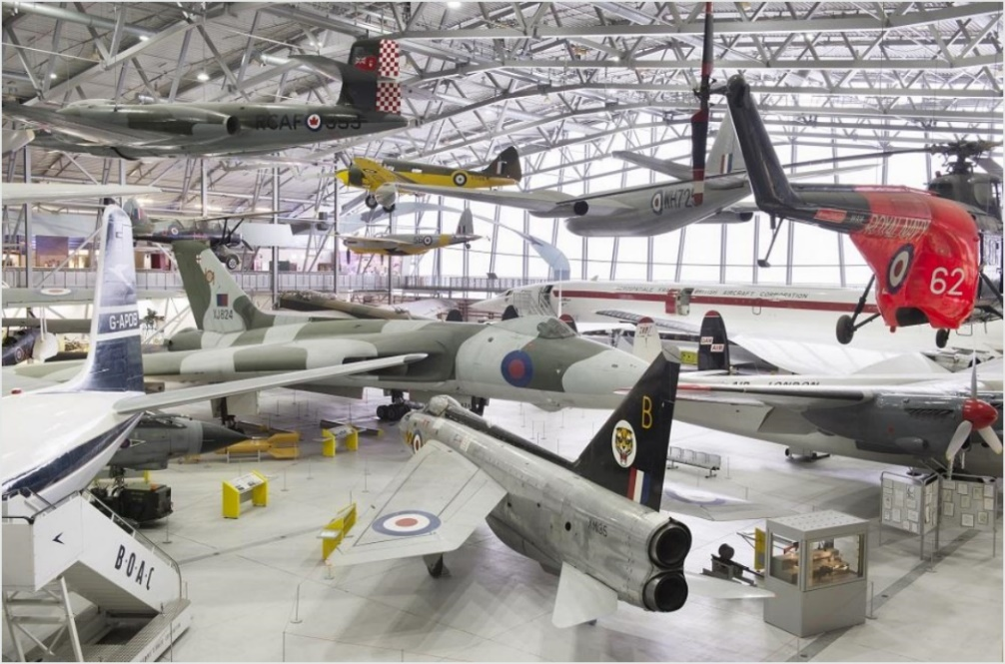
IWM Duxford Visit
What we will do: This visit offers the opportunity to learn about the early days of flight, through to the dramatic days of the Second World War and the technological advances of the Cold War. Inside every hangar and exhibition, you’ll discover iconic aircraft, see historic objects from our collections and uncover hundreds of personal stories of the many lives impacted by conflict.
This is a one-day activity within Band 2, 3, 5 and 6

Slide 17
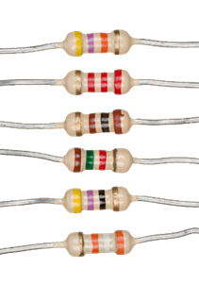
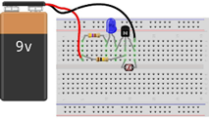
Electronics
What you will do:
You will construct circuits on prototyping boards (breadboards) to investigate several key electrical components:
· Resistors.
· Capacitors.
· Relay switches.
· Transistors.
·
By the end of the day, you will have:
· Learnt how to strip wire and construct circuits from a circuit diagram.
· Learnt how transistors, capacitors and resistors operate.
· Made a simple timer circuit using ideas of capacitance and resistance.
· Made a simple light sensor circuit that lights up an LED when the lights are turned off.
This is a one day on site activity available within Band 4, Band 7, Band 9

Slide 18
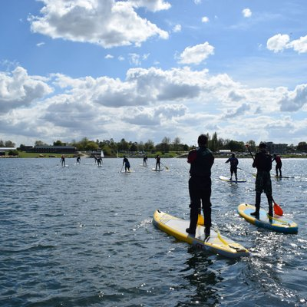
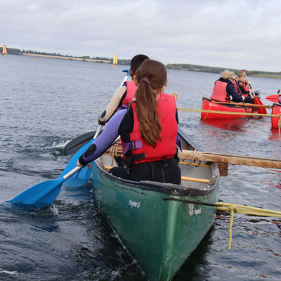
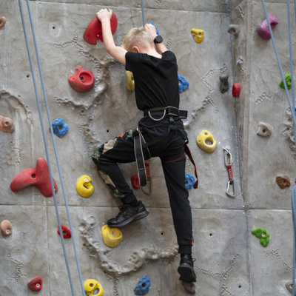
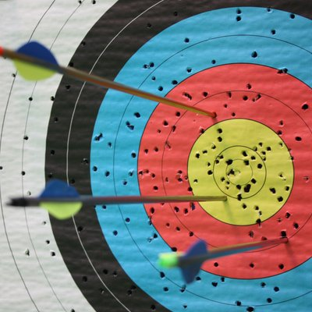
Grafham Water Centre
What you will do:
We will travel by coach to Grafham water for a day
Band 1 and Band 5 will take part in Raft Building and Stand up Paddleboarding (SUP)
Band 2 and Band 6 will be canoeing and Raft building
Band 3 and Band 4 will be dry based activities: you will take part in wall climbing and archery
This is a one day on site activity available within Band 1, Band 2, Band 3, Band 4 and Band 6

Slide 19
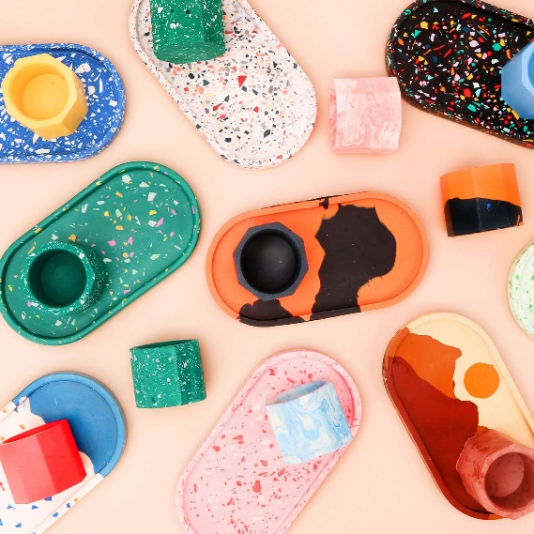
Jesmonite Casting
Jesmonite is an ecofriendly safe alternative to resin, plaster and concrete. It is fun and easy to use. It can be cast and worked in many ways to achieve stunning results. Spend the day learning how to create interesting effects and create at least 2 items that you can take home. You will be able to make a tray, candle holder or pen pot. You will be able to experiment with different surfaces and colours to create your own personalised item.
This is a one day on site activity available within Band 5, 6, 8 and 9

Slide 20
Loop Lab
Ever wondered what music sounds like when built from the world around you?
In Loop Lab you'll become a sonic explorer, capturing everyday sounds and transforming them into beats, loops, and soundtracks. Using recording technology and digital tools, you’ll learn how to manipulate, layer, and remix your found sounds into something completely unique. Get ready to experiment, create, and discover the hidden rhythms of your environment!
This is a one day on site activity available within Band 7.

Slide 21

Murder Mystery Investigation
- Whodunit?
What you will do: Collect the evidence, crack the clues and identify the criminal!
- What will you find out about yourself and others in the process?
- Psychology is all about the mind and behaviour, including how we think, feel and act. In this activity we will use psychology to help us to solve crimes.
This is a one day activity available within Band 1, Band 2 and Band 5

Slide 22
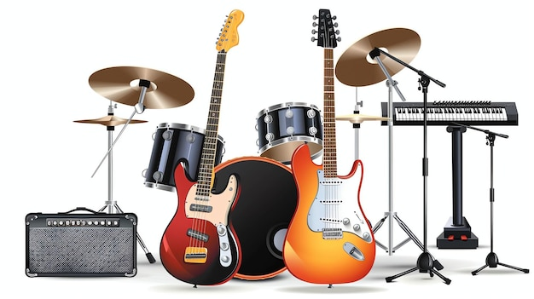
Music Week
What you could do:
freestyle composing or song-writing
percussion and instrumental workshops
instrumental / vocal skills
use of technology, e.g. microphones, amps, music software, multi-track recording
…all leading to a final showcase gig on the Friday!
Do you love music? Are you keen to record?
Would you like an opportunity to perform with others?
No matter your instrument or style - whether you want to work on covers or original material - here is an opportunity any keen musician will not want to miss: the chance to spend a week developing material in the music department, supported by music specialists.

Slide 23
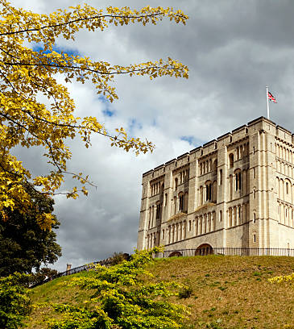
Norwich Castle
What will we do: A full day out exploring this iconic Norman castle which offers outstanding collections of archaeology, both decorative and fine art, natural history more. The castle offers an imaginative and inclusive learning programme and pupils encouraged to actively engage with the past. There will be a chance to enjoy a picnic in the castle gardens.
Essential information: Pupils will be back after the school buses have left and will need to arrange transport home.
This is a one day activity within Bands 8, 9 and 14

Slide 24
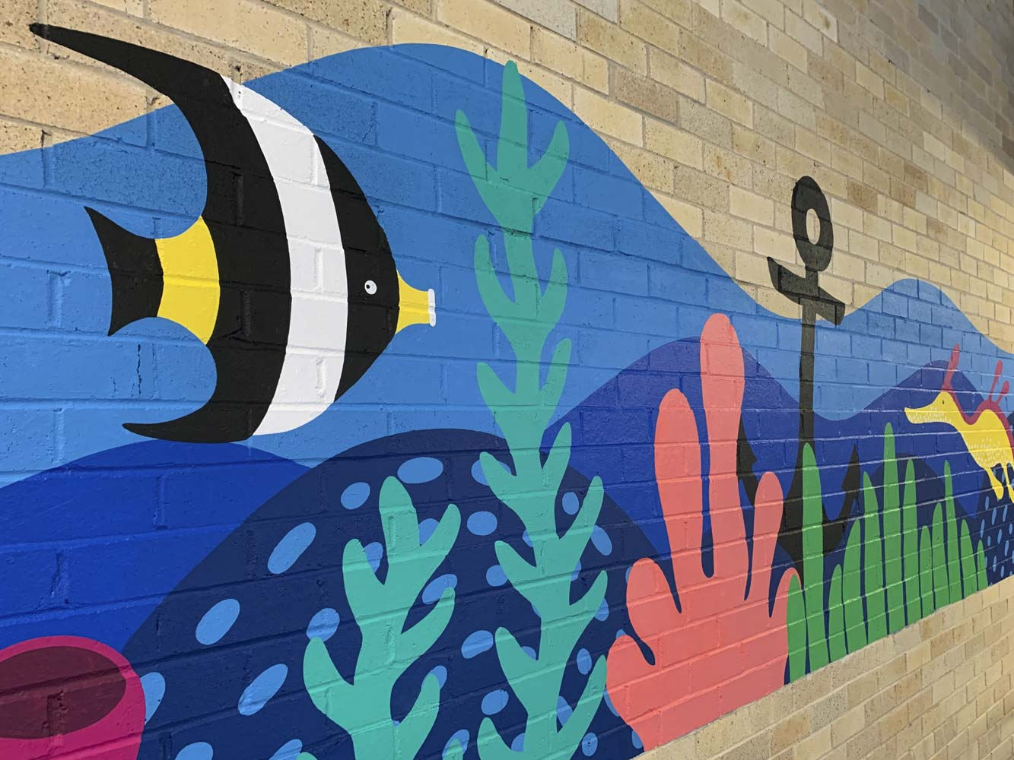
Murals and Printmaking
What will we do: This art day is for arty pupils who want to do a solid day of visual creativity. There will also be an opportunity to learn a printmaking technique and create a series of prints to take home.
Extra Information: Remember that painting and printmaking can ruin clothes so dress appropriately or bring an apron.
This is a one day activity within Bands 1, 5 and 6

Slide 25
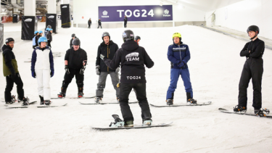
Year 8 Snowboarding Week
What we will do: -Spend four days learning how to snowboard on real snow! Professionals will lead sessions teaching the basics then try out some moves on the slopes in recreational boarding sessions. Boards, bindings, boots and helmets are included. On the Wednesday, you will spend the day at Milton Keynes shopping centre. Here you will have you will have some free time to shop, and we will meet and have a group lunch at one of the restaurants.
Important Information: Please note that this a very physical activity which will require a good level of fitness. Those who opt out part way through the week will not be refunded as costs are paid in advanced. This activity is Ideal for anyone who has an interest in snowboarding. Beginners to intermediate boarders welcome but probably most suitable for those still learning.

Slide 26
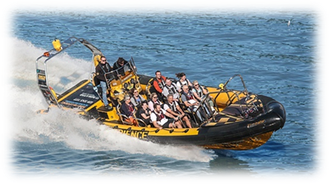
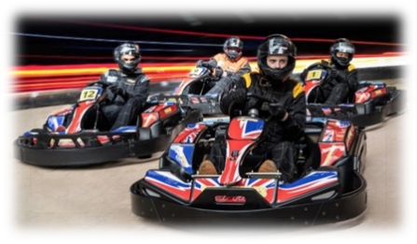

SPEED Week
What you will be doing:
- Test yourself on some of the UK’s fastest electric go karts on a testing indoor track
- Ride the UK’s fastest rollercoasters at Thorpe Park
- Immerse yourself in the word of F1 racing on some of the world’s most advanced racing simulators
- Pit yourself against high moving projectiles in one of the area’s best paintball locations.
Important Information: This activity is for a full week. Due to the distance of the venues, some of the days we will not be back in time for the school buses.

Slide 27
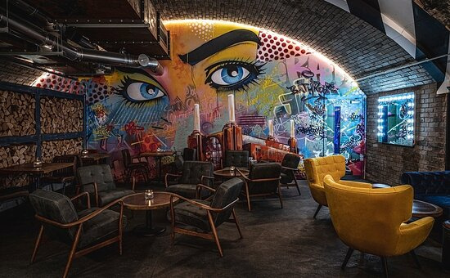
Spray Can Art
An amazing opportunity to develop your art skills. You will work with a world-famous graffiti artist for the day and learn how to create a piece of graffiti art on a large 2 metre board.
What will we do: The day will include you learning how to design the lettering, practice and learn a range of spray-painting techniques and then produce a large graffiti artwork in small groups during the afternoon.
Extra information: Spray paint can get on your clothes so wear appropriate clothing or an apron This is a planned one activity within Band 1, Band 2 and Band 3 .
The photo shows some recent the artist did on the walls of a Gordon Ramsey Restaurant.

Slide 28
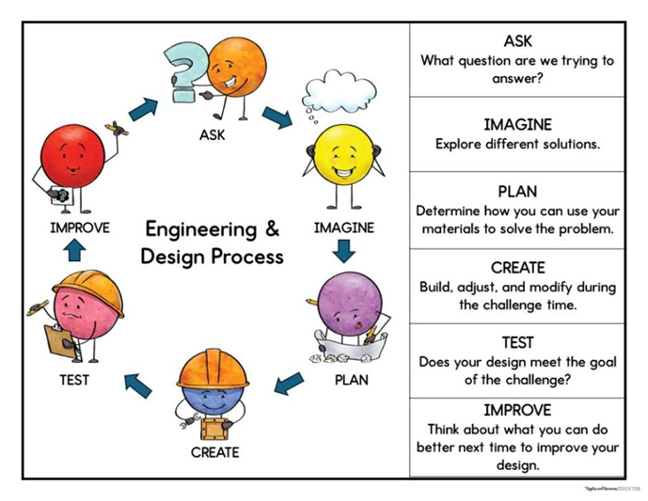
STEM Challenge Day
What will we do: Use your STEM skills to design solutions to real world problems.
This is an on site one day activity within Band 5, Band 7, Band 8

Slide 29
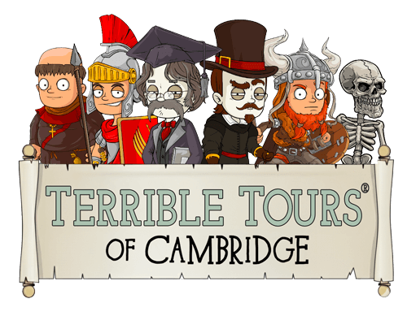
Terrible Tours of Cambridge
This is a walking tour of Cambridge. Cambridge isn’t just about gowns, bicycles and colleges – it’s a city shaped by Romans, Saxons, Vikings, Normans and countless colourful characters since. Terrible Tours will bring the stories to life with humour, energy and a healthy dash of gruesome. By the end of the day, we will have discovered a fresh appreciation of Cambridge.
Extra information: This is a planned one day activity within Bands 3 and 7

Slide 30
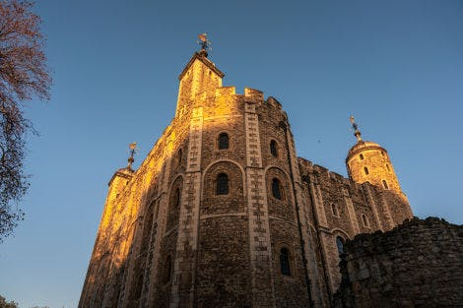

Tower of London
What you will do:
We will travel by coach into London to explore this iconic castle and World Heritage Site. We can get up close to the Crown Jewels, Meet the legendary Yeoman Warders and ravens and see the Tower like never before.
Pupils should bring a packed lunch and small amounts of money if they wish to buy snacks or souvenirs.
Note that pupils will be back after the school buses have left and will need to arrange transport home.
This is a one day on site activity available within Band 1 and Band 6

Slide 31

Ultimate Frisbee
Ultimate Frisbee is a fun and fast-paced mixed team sport played with a disc (frisbee). Come and learn how to play from a former Great Britain player. We will do some drills, play some games and have a lot of fun along the way.
Find out more about the sport at www.ukultimate.com/learn.
This is a one day on site activity available within Bands 2 and 3

